Slide 2
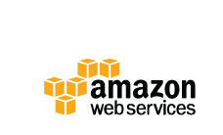
Introduction to Cloud Computing
with Amazon Web Services
Aman Khan
Devops Enthusiast

Slide 3
Firstly, let’s do some Introductions
• Me
• Aman Khan
• Devops Engineer with Global Logic
• You
• Have never used AWS before, or you have just started on your journey with AWS
• Are wanting to better understand the value of ‘the cloud’
• Are wanting to better understand what AWS provides and how other customers are
using it

Slide 4
Today’s Agenda
• History & Evolution of AWS
• Global Footprint
• Service breadth and depth
What Sets AWS Apart!
• What Gartner has to say about AWS?
How to get further | References | Q & A

Slide 5
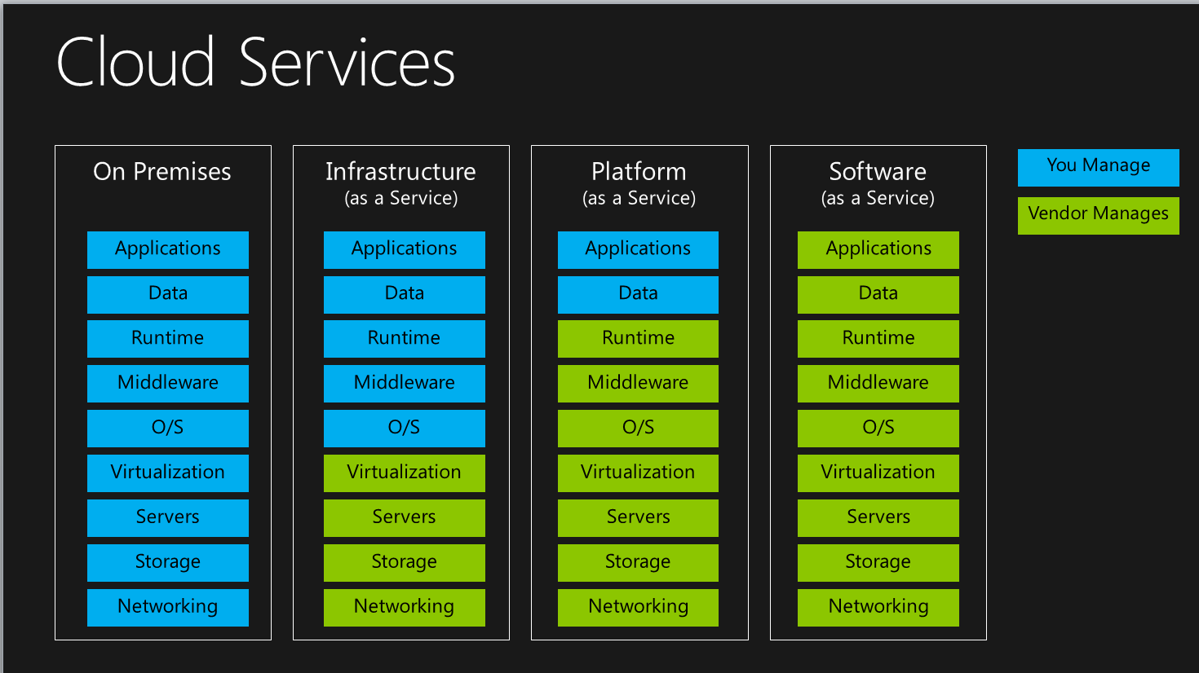
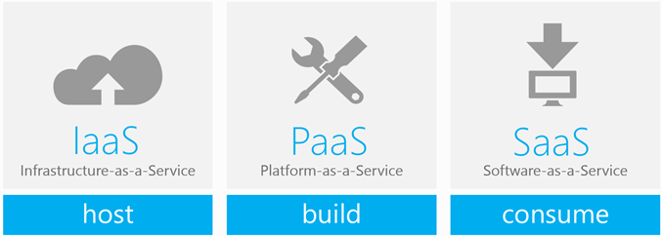
The cloud is a very broad concept, and it covers just about every possible sort of online service, but when businesses refer to cloud procurement, there are usually three models of cloud service under consideration:
Software as a Service (SaaS)
Platform as a Service (PaaS)
Infrastructure as a Service (IaaS)

Slide 6
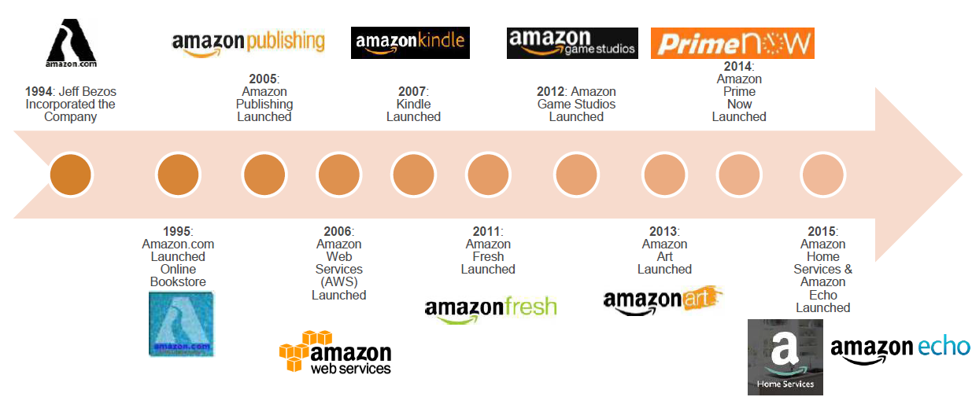
History of AWS

Slide 7
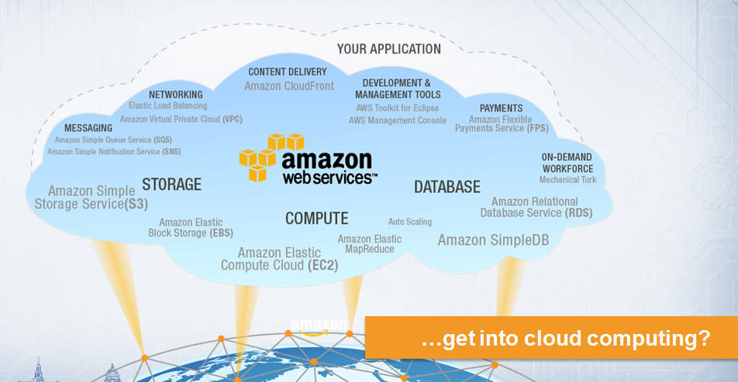

Slide 8
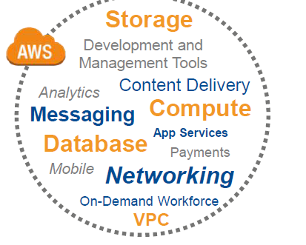
Amazon Web Services (AWS)
• Born from the learning's of running amazon.com
Over 12 year’s in the making
Enablement of the seller’s on Amazon
• First launched in 2006
• Customer obsession is in their DNA !

Slide 9
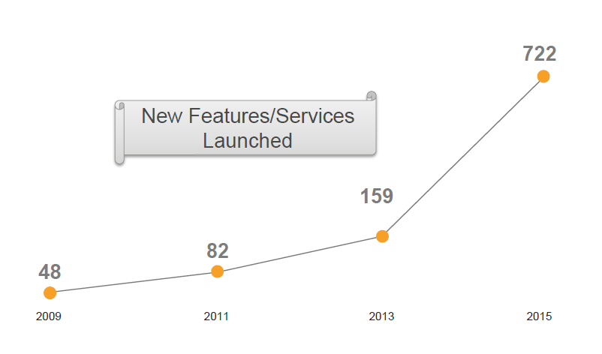
AWS Rapid Pace of Innovation
Since inception AWS has
• Released 1111 new services and features
• Introduced more than 75+ major new services
• Announced 50+ price reductions

Slide 10
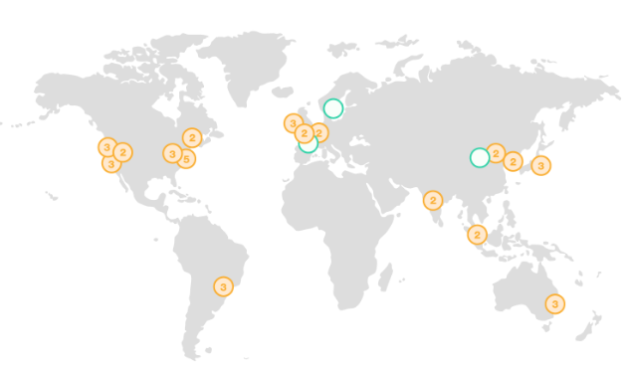
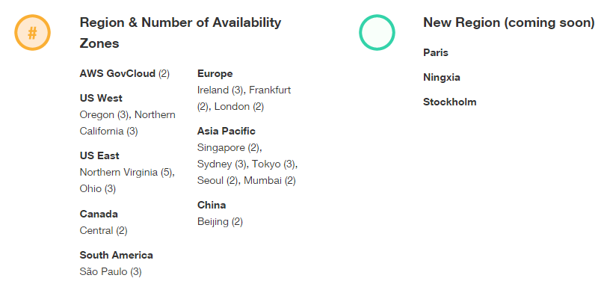
Global footprint
Over 1 million active customers across 190 countries
900+ government agencies
3,400+ educational institutions
16 Geographical regions( 3 more Regions + 8 New AZ )
42 Availability Zones (= 1-6 data centers)
70+ edge locations

Slide 11
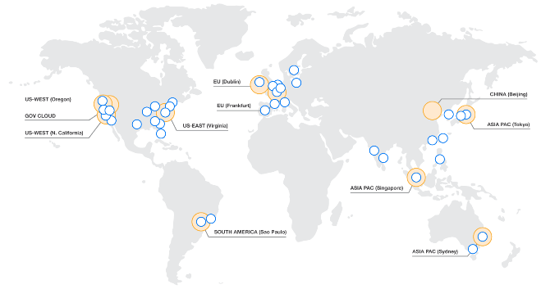
Example AWS region
AZ
Transit
1 of 16 AWS world-wide AWS regions
Redundant paths to transit centers
Transit centers connect to:
- Private links to other AWS regions
- Private links to AWS Direct Connect customers
- Internet through peering and paid transit
Metro-area DWDM links between AZs
82,864 fiber strands in region
AZs < 2 milliseconds apart and usually < 1 millisecond
25 Tbps peak inter-AZs traffic
AZ
AZ
AZ
AZ
Transit

Slide 12
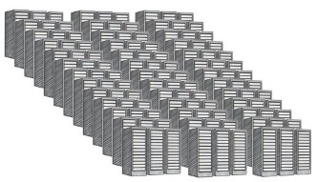
Example AWS Availability Zone
AZ
Transit
AZ
AZ
AZ
Data Center
Data Center
AZ
Transit
1 of 42 AZs worldwide
Each AZ is 1 or more data center
No data center is in two AZs
Some AZs have as many as 6 data centers
All regions have 2 or more EC2 AZs
DCs in AZ less than ¼ milliseconds apart
Don’t need inter-AZ independence
Do require low latency and full B/W
Data Center
Data Center

Slide 13
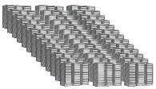
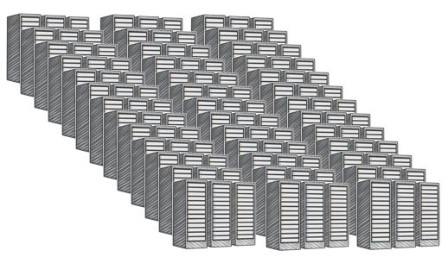
Example AWS data center
Single data center typically more than 50,000 servers and often more than 80,000
Larger data centers undesirable (blast radius)
Up to 102 Tbps provisioned to a single data center
AWS custom network equipment:
Multi-ODM sourced
Amazon custom network protocol stack

Slide 14











































Service breadth and depth
support
professional
services
partner
ecosystem
training and certification
Solutions
Architects
account
management
security and pricing reports
technical and
business support
virtual
desktop
sharing and
collaboration
business
email
enterprise
applications
Analytics
App Services
Developer Tools and Operations
Mobile Services
Hadoop
queuing and notifications
transcoding
deployment
resource
templates
identity
real-time
streaming data
sync
workflow
email
DevOps
containers
data
warehouse
Mobile
Analytics
app
streaming
application lifecycle
management
event-driven computing
data
pipelines
search
push
notifications
platform
services
identity management
access control
resource and usage auditing
key management and storage
monitoring
and logs
administration
and security
compute
storage
CDN
databases
networking
core
services
(VMs, Auto Scaling, and load balancing)
(object, block, and archival)
(Relational, NoSQL, Caching)
(VPC, DX, DNS)
regions
Availability
Zones
points of presence
infrastructure

Slide 15
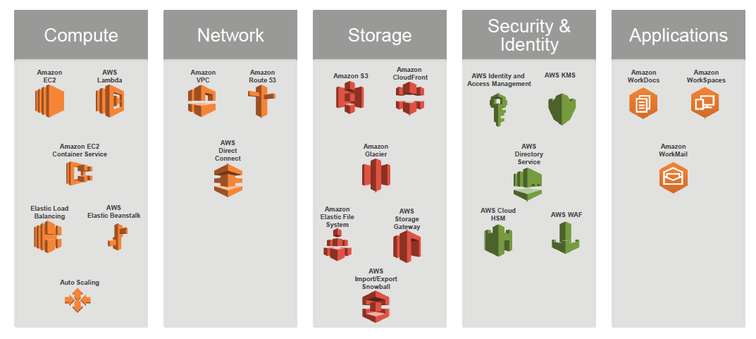
AWS Foundation Services

Slide 16
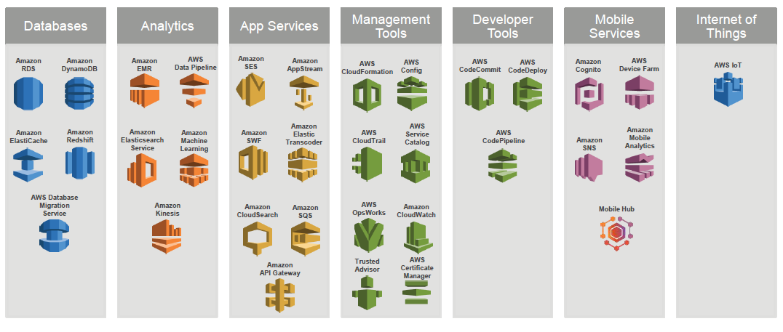
AWS Platform Services

Slide 17


Why Leveraging AWS is an absolute advantage!
Trade capital expense for variable expense ( pay-as-you-go )
Benefit from massive economies of scale.
Stop guessing capacity.
Go global in minutes.
Increase speed and agility.
Highly reliable for price point.
Stop spending money on running and maintaining data centers.

Slide 18
You and AWS share responsibility for security
customer applications and content
You get to define your controls in the cloud
mission
owner &
partner
access control
network
security
server security
data
security
AWS foundation services
compute
storage
database
networking
AWS takes care of the security of the cloud
AWS global infrastructure
Availability Zones
edge locations
regions

Slide 19

What sets AWS apart?
Experience
building and managing cloud since 2006
Service breadth and depth
75+ services to literally support any cloud workload !
Pace of innovation
history of rapid, customer-driven releases
Global footprint
16 regions, 42 Availability Zones, 70+ edge locations
Pricing philosophy
50+ proactive price reductions to date
Ecosystem
thousands of partners: 2,100+ AWS Marketplace products
*as of July 31, 2014

Slide 20



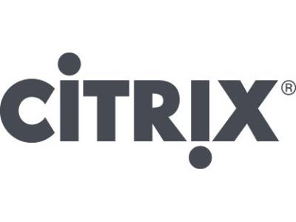









Expansive ecosystem
thousands of the world’s largest technology and consulting companies
31 Global Premier Consulting partners
8 enterprise-focused competencies
2,100+ products available for one-click deployment across 23 distinct product categories
customers run over 70 million hours of software per month

Slide 21
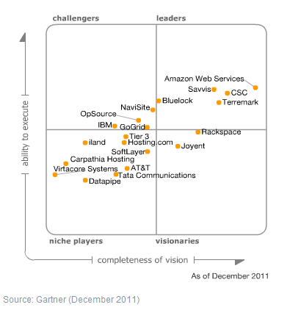
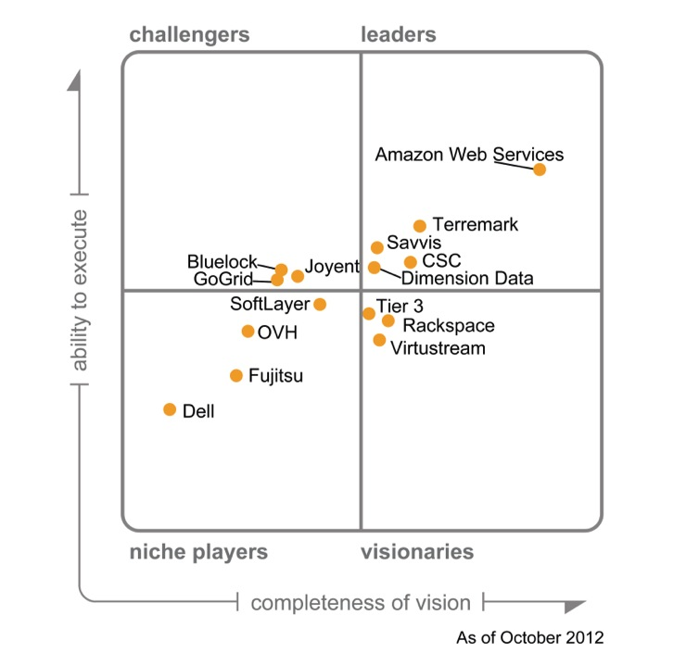
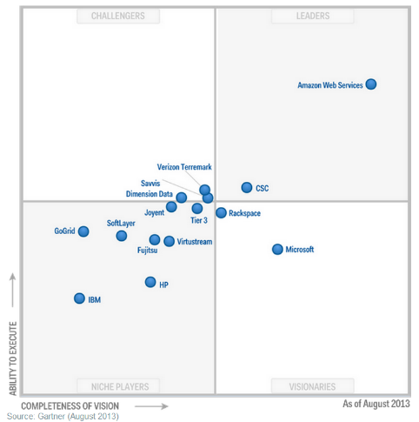
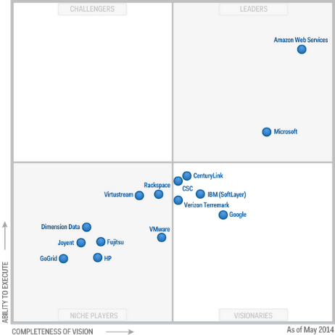
Gartner Magic Quadrant past 6 years
2011
2012
2013
2014
“AWS is the overwhelming market share leader, with more than five times the compute capacity in use than the aggregate total of the other fourteen providers.”

Slide 22
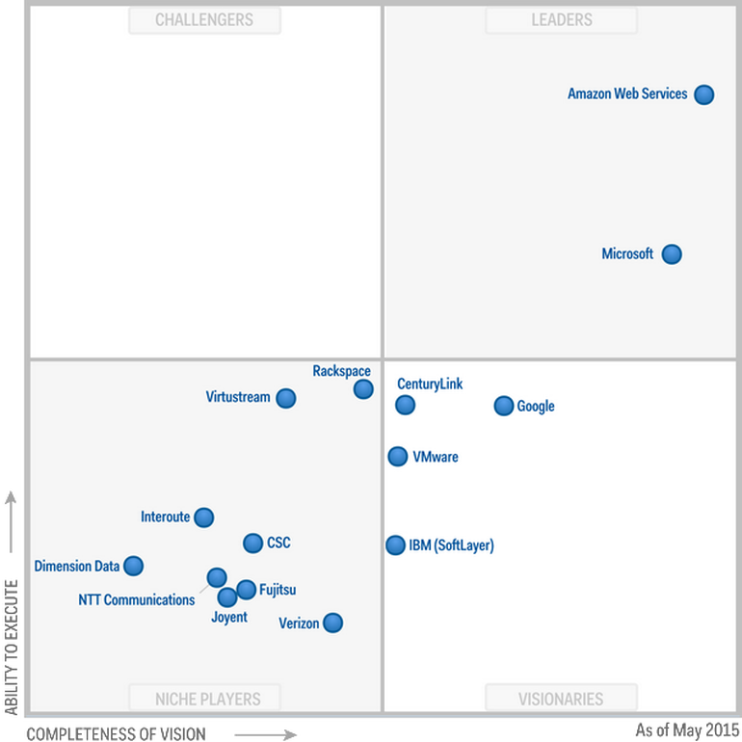
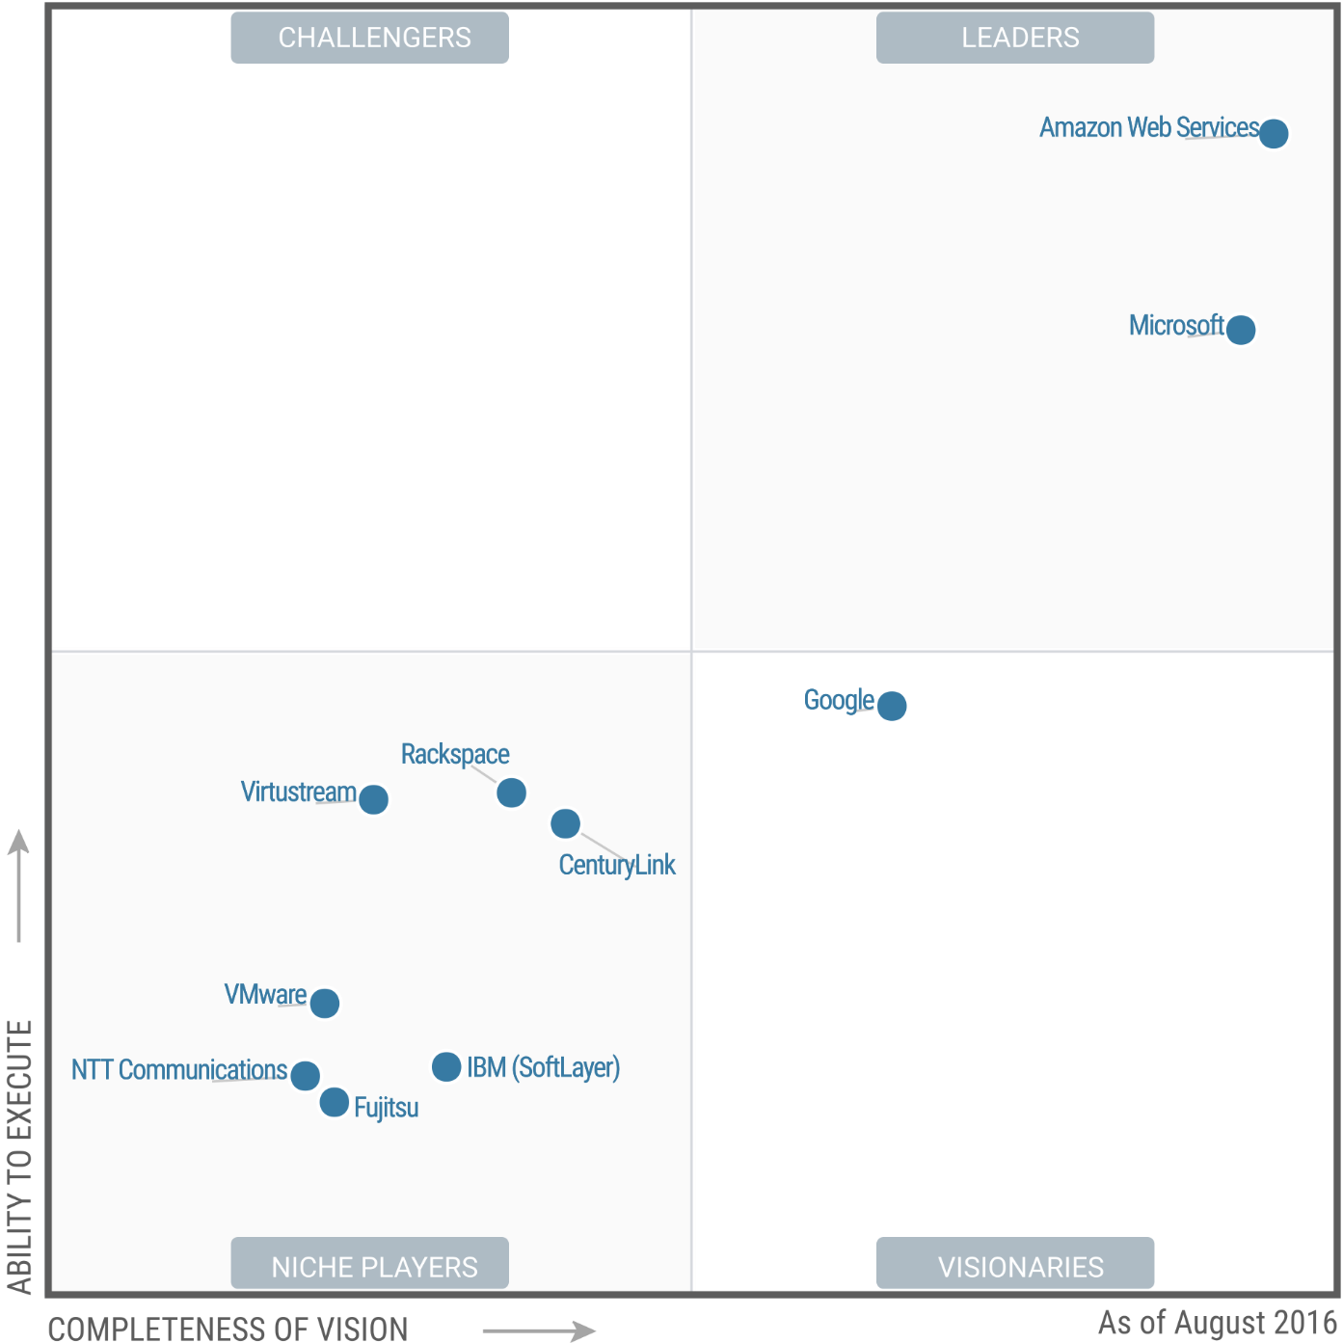
2015
2016
AWS named as a leader in the Infrastructure as a Service (IaaS) Magic Quadrant report for 6th consecutive year*

Slide 23
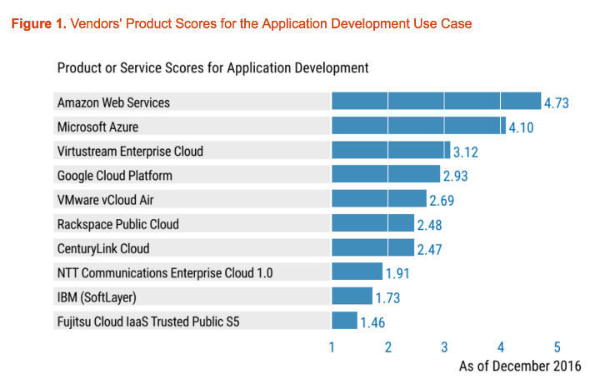
In the 2016 Critical Capabilities for Public Cloud Infrastructure as a Service, Worldwide, Gartner scored Amazon Web Services highest in all five use cases:
Application Development (4.73)
Batch Computing (4.80)
Cloud-Native Applications (4.69)
General Business Applications (4.37)
Internet of Things (4.63).

Slide 24
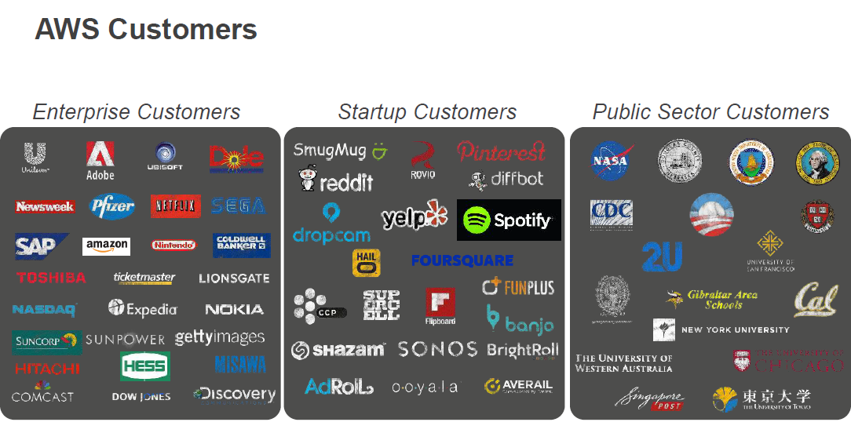

Slide 25
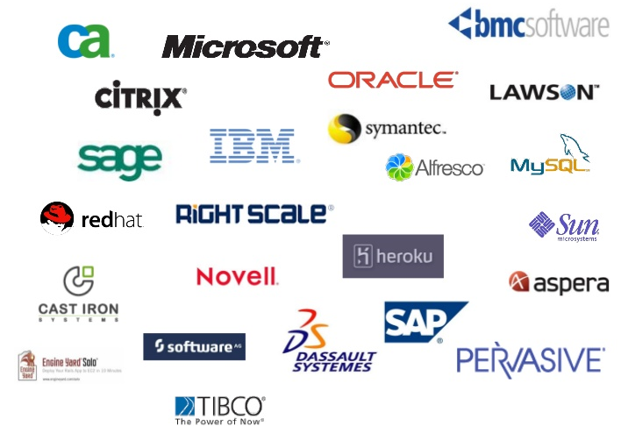
few more…..

Slide 26

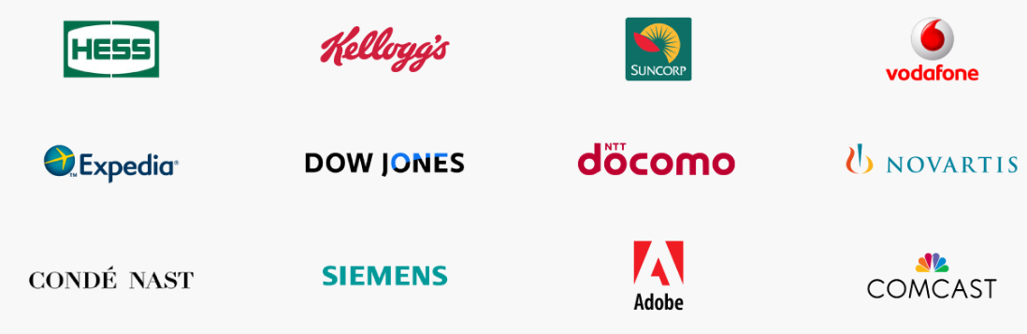

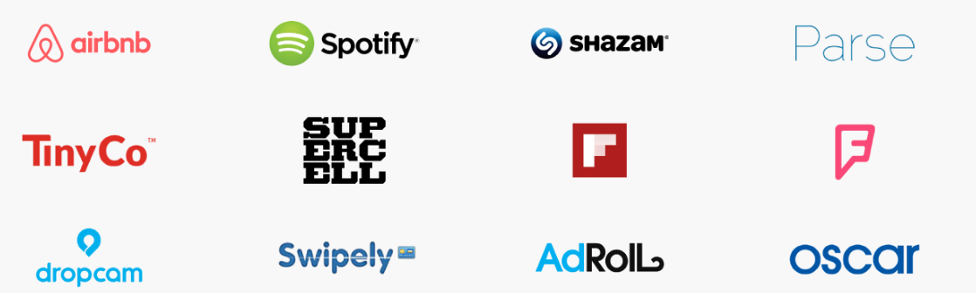

Slide 27



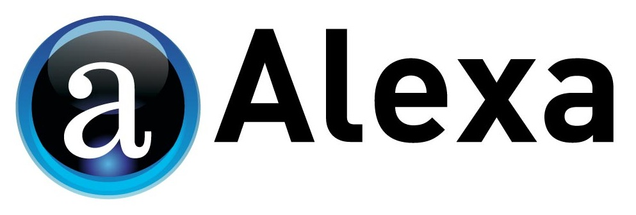




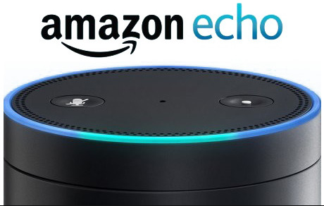




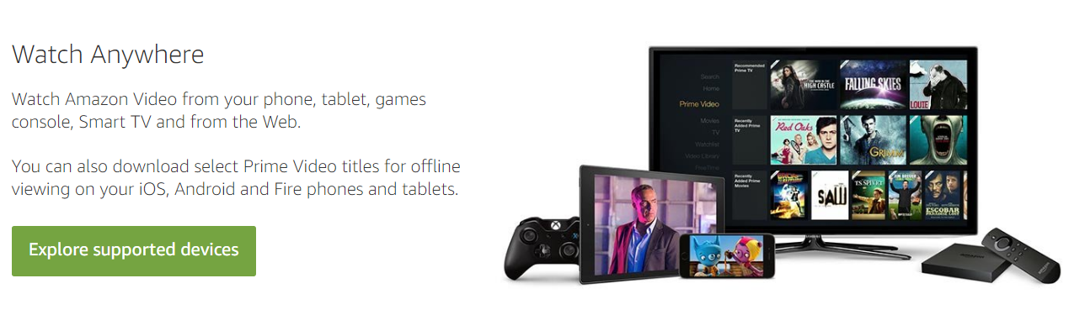



Amazons Family of Businesses

Slide 28
AWS mission
Enable businesses and developers to use web services* to build scalable, sophisticated applications.
*what people now call “the cloud”

Slide 29

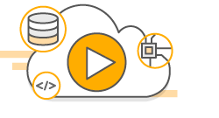





Reference
https://aws.amazon.com/about-aws/
AWS Training https://aws.amazon.com/training/
YouTube AWS Channel https://www.youtube.com/user/AmazonWebServices
AWS Twitter Handle https://twitter.com/awscloud
AWS Blog https://aws.amazon.com/blogs/aws/
AWS What’s New https://aws.amazon.com/new/
qwikLABS https://aws.qwiklabs.com/

Slide 30
Thanks….!
Questions & Answers

